Slide 1
Some aspects of surface mapping
Rhaleb Zayer
Talk at Lycée Arthur Varoquaux

Slide 2
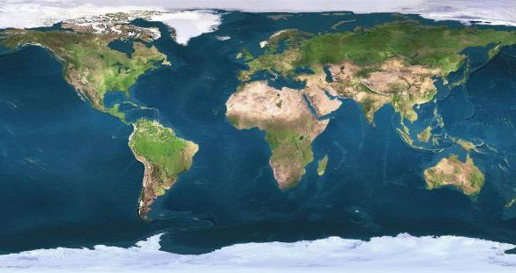
About me!
Currently researcher at INRIA
2008: Research Associate at Max-Planck-Institut für Informatik
2007, Ph.D. in Computer Science
  Max-Planck-Institut für Informatik, Saarbrücken, Germany
2002, B.S./M.S. in Mathematics
  Drexel University, Philadelphia PA, USA

Slide 3
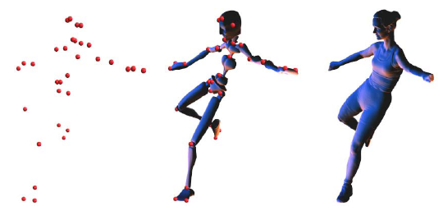
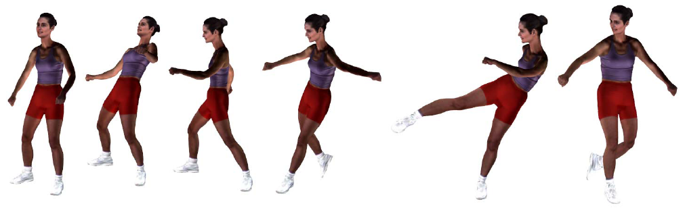
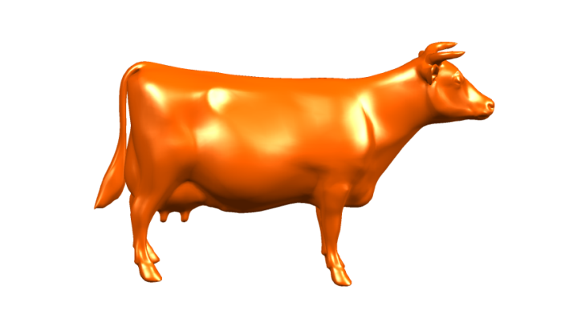
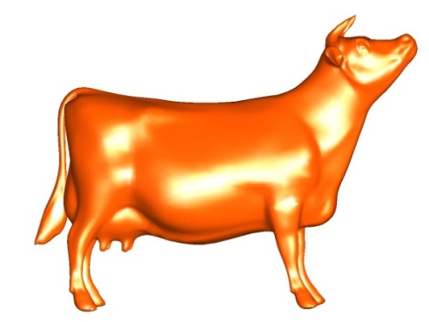
Research activity
Topics investigated
  Digital geometry processing
  Acquisition
  Mechanical aspects of shape deformation from

Slide 4
Warm up

Slide 5
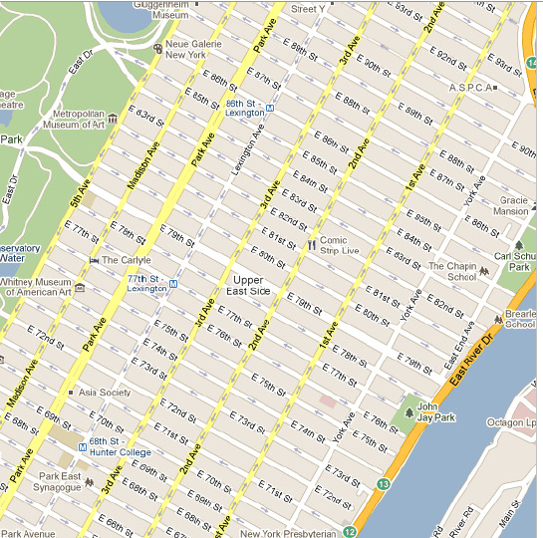
What is a distance?

Slide 6
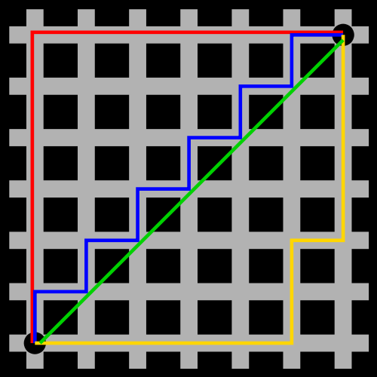
A mathematical view
No buildings (Math is dry :)

Slide 7
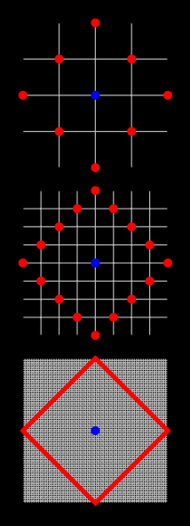
A mathematical view

Slide 8
A mathematical view

Slide 9
A mathematical view

Slide 10
A mathematical view

Slide 11
The way we apprehend our space depends on the metric we choose (how we define distances)
…and how we measure them

Slide 12
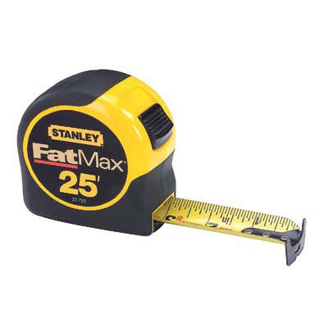
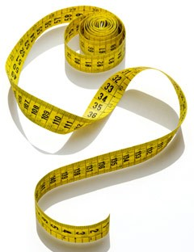
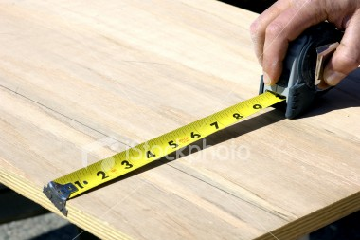
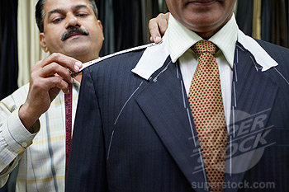
Carpenter vs. Tailor

Slide 13
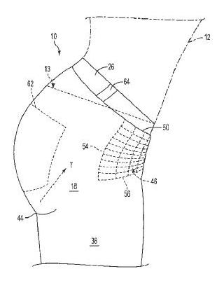
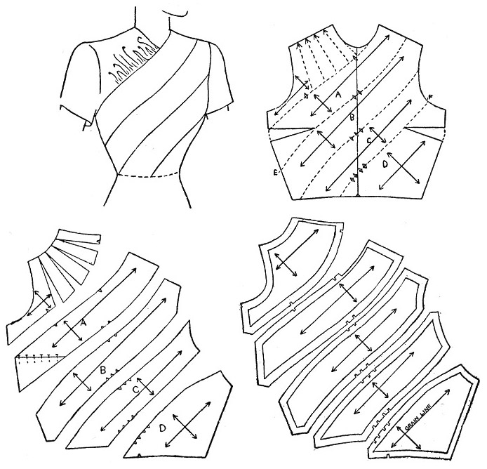
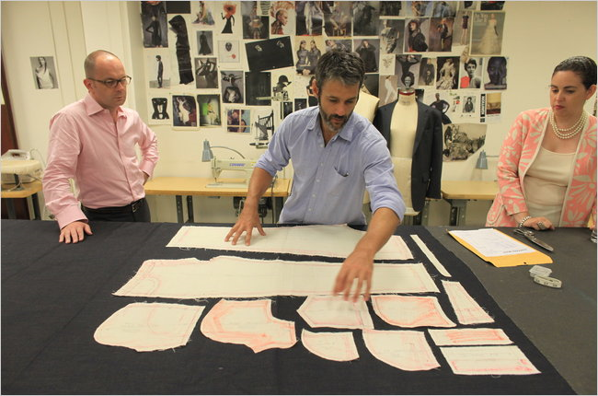
Through a tailor’s eye!

Slide 14
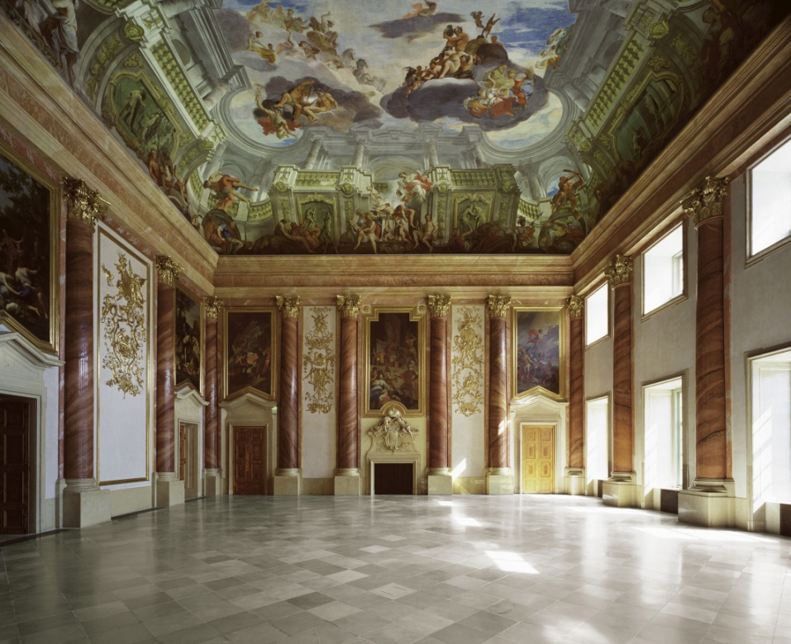
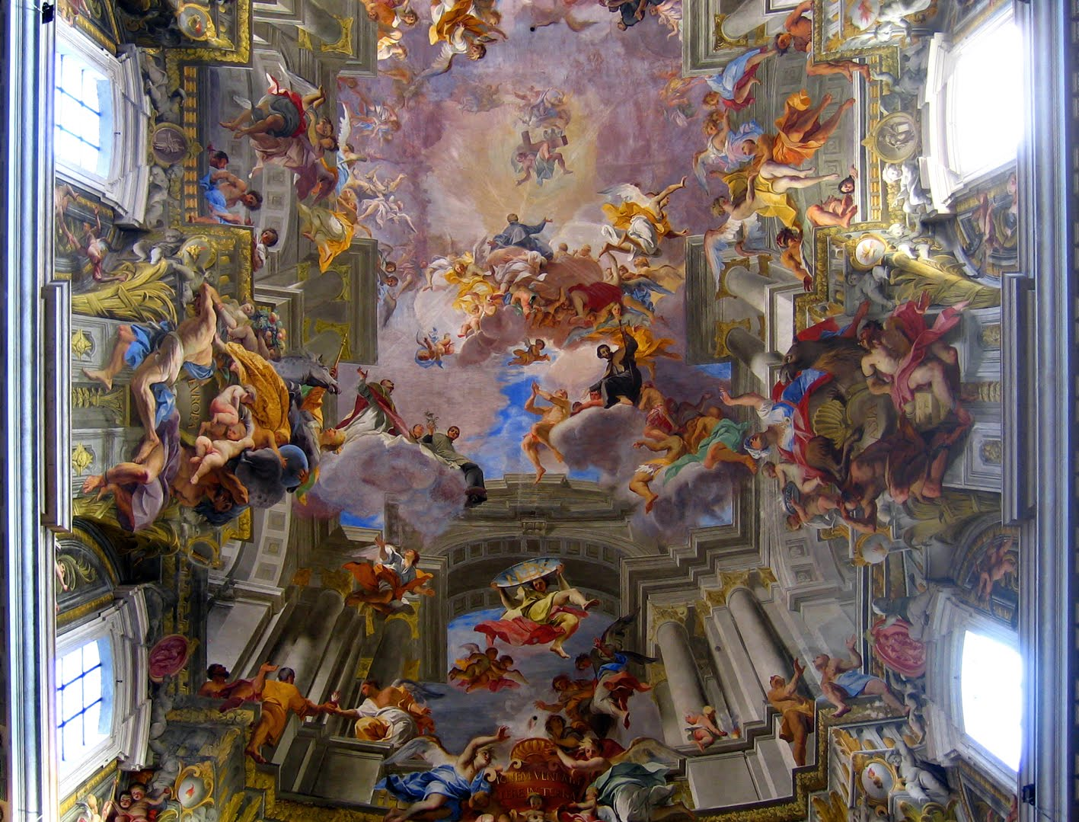
Painters
Decorating curved ceilings

Slide 15
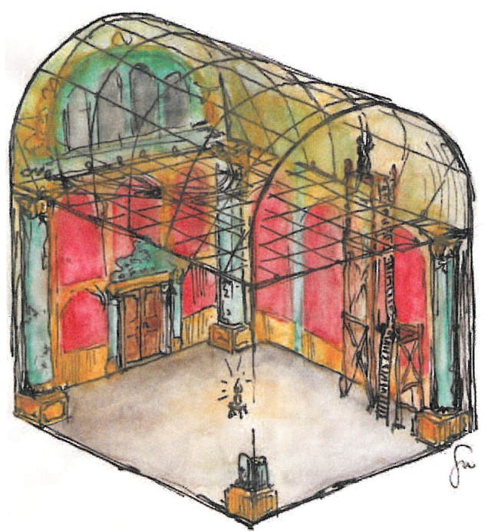
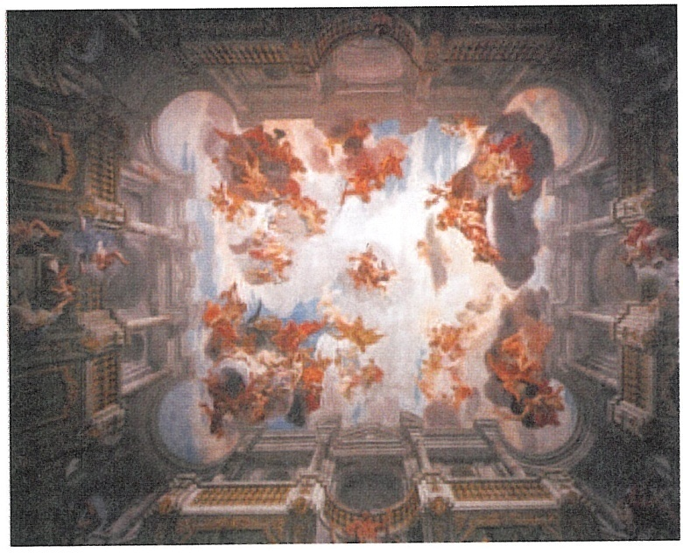
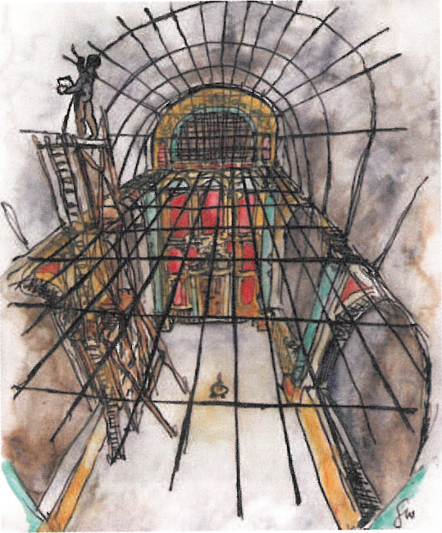
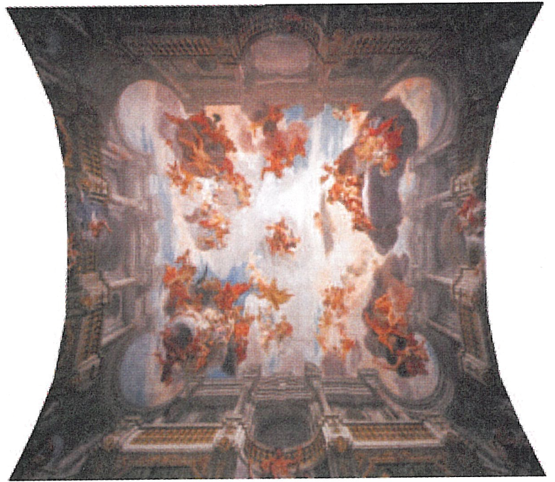
Painters at work!
Notes:
Andrea Pozzo---- The Church of Saint Ignatius of Loyola is one of the most important baroque church of Rome.

Slide 16
Working on curved surface requires accounting for distortion.
Distances on curved surfaces are not the same as on the plane ☺

Slide 17
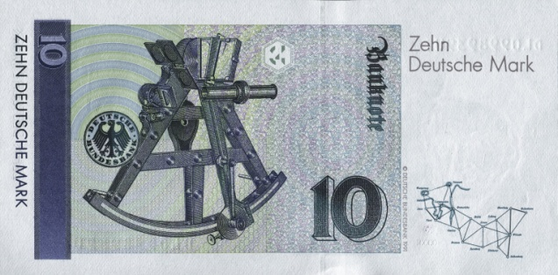
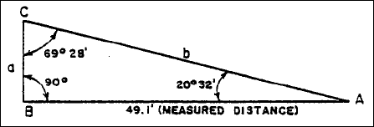
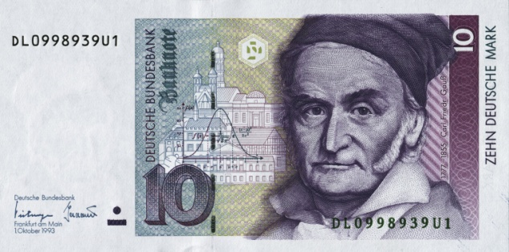
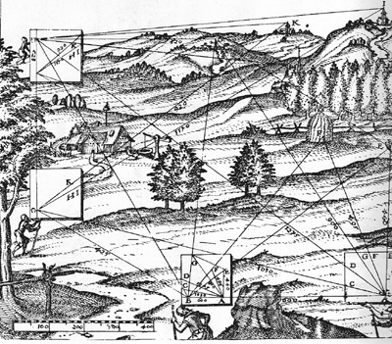
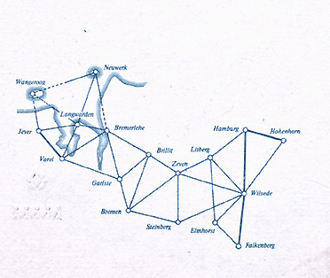
How maps used to be made?
Notes:
The idea of working with triangles is not knew. The importance of land measurements has steered the development of simple but reliable techniques for measuring distances.
Knowing one edge of a triangle and two angles it is possible to know the length of other edges.
Gauss was a pioneer of such technique and his triangulation of the kingdom of hanover is
commemorated in the back of the ten marks bill.

Slide 18
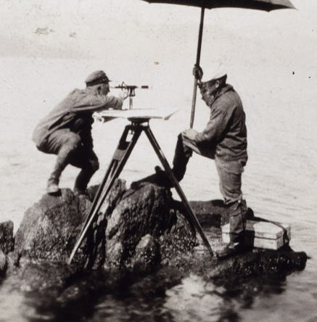
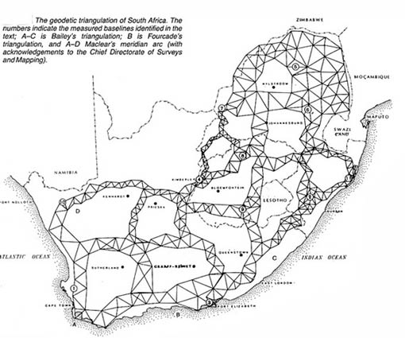

Slide 19
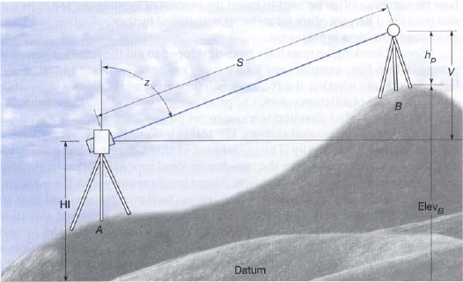
Measuring curved surfaces

Slide 20
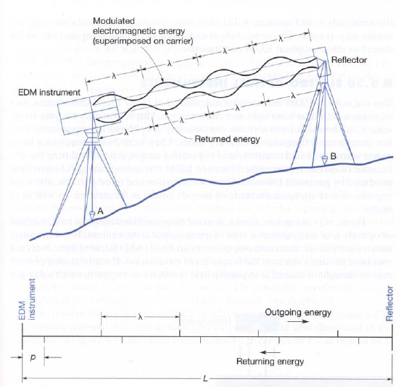
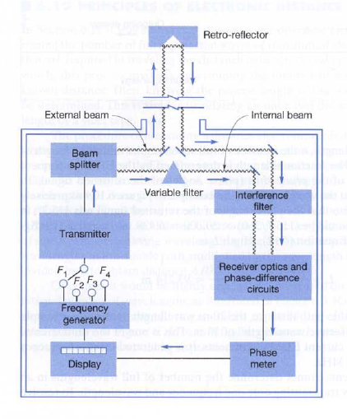
Modern distance measurements

Slide 21
Demo Time of Flight (ToF) camera

Slide 22
Computer Graphics

Slide 23
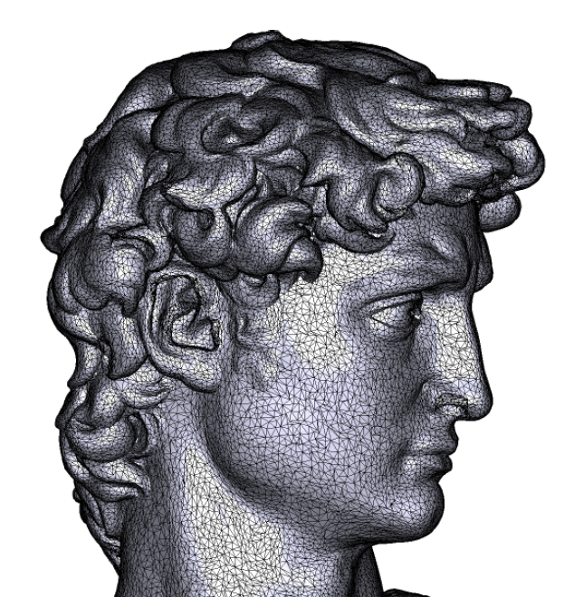
Data representation
Most of acquired data comes as unstructured meshes

Slide 24
Mesh representation
Standard mesh format: counter clockwise triangulation table
7
4
V1 | V2 | V3
1 | 2 | 3
3 | 4 | 1
1 | 5 | 6
7 | 3 | 2
1 | 6 | 2
1 | 4 | 5
x | y | z
0.0000 | 0.000 | 1.000
1.252 | 1.379 | 0.000
-1.275 | 1.378 | 0.013
-1.468 | -0.918 | 0.032
-0.293 | -2.259 | 0.117
1.824 | -0.789 | 0.028
-0.012 | 3.325 | 0.077
3
1
2
2
5
1
6
3
4
6
5

Slide 25
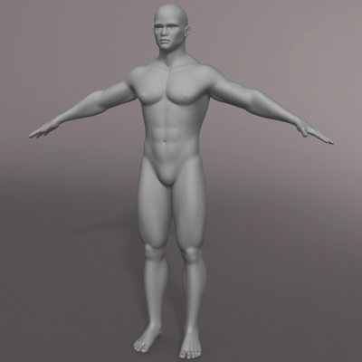
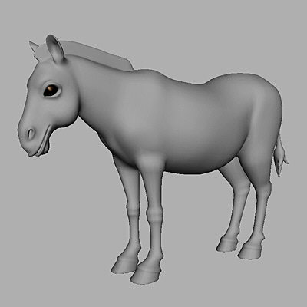
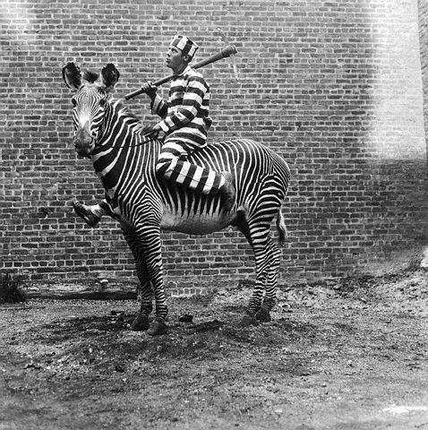

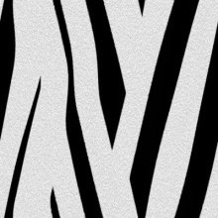
Motivation
Courtesy of Corbis images
Graphics ingredients
Real world
Notes:
Starting from acquired or artistically modeled data, the aim is to mimic the real world.
For this purpose two standard techniques are used texture mapping and surface editing.
The goal is to imitate or reproduce a the real world using the current ingredient. As our work focuses on the geometry part
Generally two fundemental techniques in the graphics are needed to induce more realism to the model (either captured or modeled)
Texture mapping and surface editing.

Slide 26
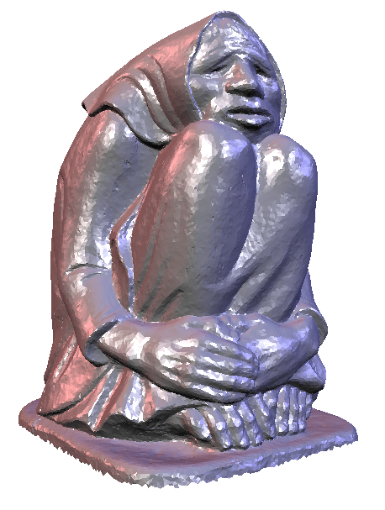
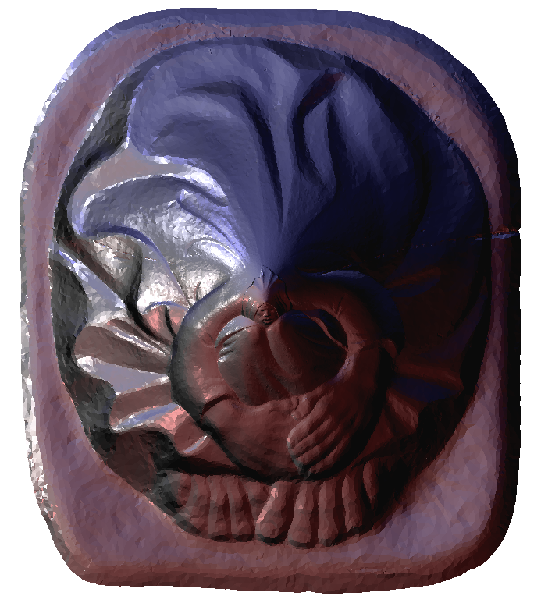
Surface Parameterization

Slide 27
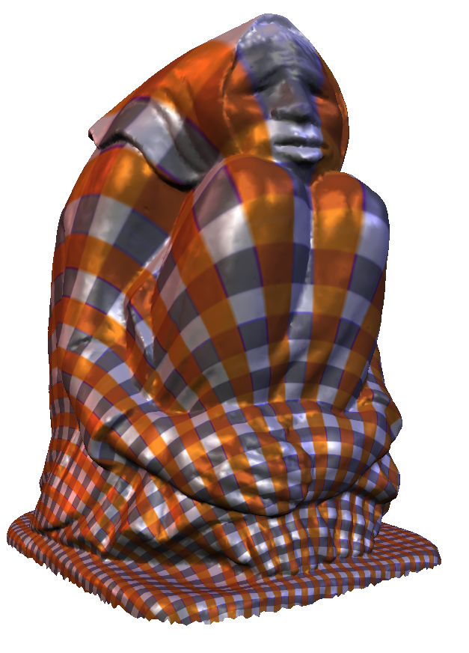
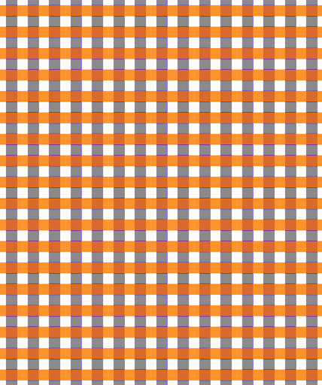
Surface Parameterization
Notes:
Can we preserve distances---discuss , we preserve orthogonality

Slide 28
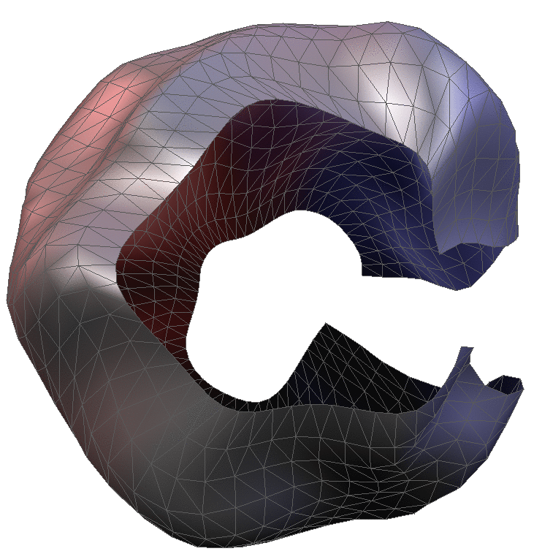
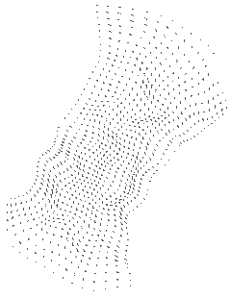
Surface parameterization
Fundamental problem: establish a 1-1 and onto map between a 3D patch and texture domain
Wish list:
  Low distortion
  Robustness
  Efficiency
  Ease of implementation (simply beautiful and beautifully simple)
Notes:
Surface parameterization is the standard techniques for texture mapping.
Surface parameterization is a broad topic. We will restrict ourselves in this talk to the fundamental
problem which is concerned with establishing a 1-1 map between surface and a parametric domain
If we were to formulate a wish list.
About 150 papers
Many of the existing methods fulfill these requirements to varying degrees.

Slide 29
Back to the drawing board

Slide 30
Challenge!
What conditions on angles should we impose to flatten this shape correctly
6
5
4
1
3
2

Slide 31
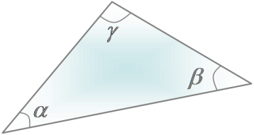
Angle based approach
First attempt
6
5
6
5
4
4
1
3
2
3
1
2

Slide 32
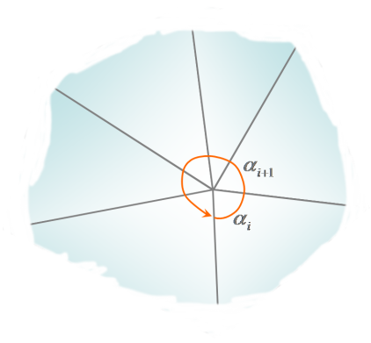
Angle based approach
Second attempt
6
6
5
5
4
1
1
3
2
4
2
3

Slide 33
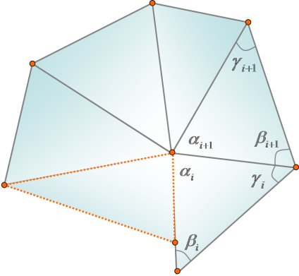
Angle based approach
Second attempt
6
6
5
5
4
1
1
3
2
4
2
3

Slide 34
Summary of validity requirements
Validity of the planar triangulation requires
  Triangle consistency
  Vertex consistency
  Wheel consistency

Slide 35
Problem formulation
Find angles that are as close as possible to the original 3D angles while satisfying the validity constraints
  Minimize :
    Subject to validity constraints (1), (2), and (3)
  Highly nonlinear problem because of (3)

Slide 36
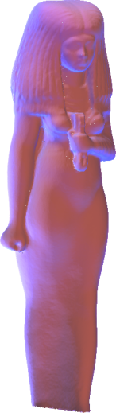
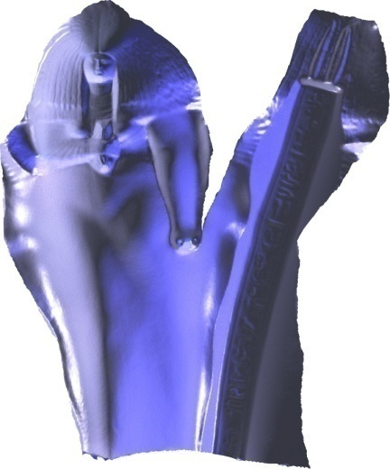
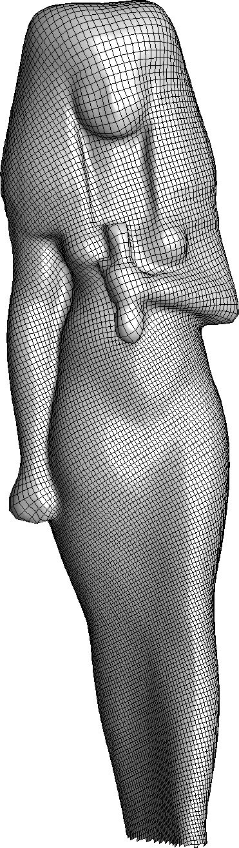
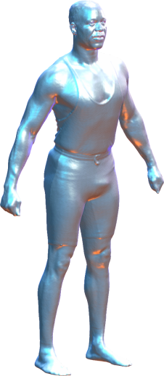
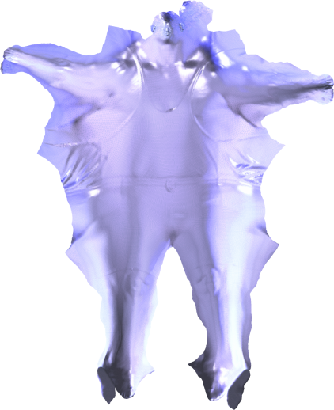














Results

Slide 37

Timing and error comparison
Model #tri timing Angular distortion
ABF++ LinABF ABF++ LinABF
obtuse 3 0.1s 0.05s 1.267 1.267
cow 5.8K 0.45 s 0.1 s 5.041e-3 5.256e-3
fandisk 13 K 0.85 s 0.15 s 5.041e-3 5.256e-3
teapot 14K 3 s 0.3 s 2.154e-3 2.282e-3
foot 20K 2 s 0.4 s 1.867e-4 1.921e-4
bull 34K 4 s 0.8 s 5.323e-4 5.331e-4
bunny1 40K 5.5 s 0.9 s 2.597e-4 2.593e-4
dino 48K 15 s 1 s 1.363e-3 1.184e-3
kiss 48K 8 s 1 s 7.092e-4 7.109e-4
tweety 54K 8.6s 1.5 s 1.5671e-4 1.5672e-4
bunny2 70K 13s 2 s 2.232e-4 2.243e-4
hand 73K 13 s 2 s 1.191e-4 1.213e-4
camel 78K 23 s 2.5 s 5.896e-4 6.202e-4
horse 97K 34 s 3 s 2.746e-4 2.906e-4
man 120K 36 s 2.7 s 5.293e-4 5.602e-4
head 128K 87 s 3.5 s 1.243e-4 1.240e-4
male 293K 272 s 9.5 s 3.577e-4 3.841e-4
Isis 374K 250 s 11.5 s 4.834e-5 4.7941e-5
David 505K 355 s 12 s 5.776e-4 5.844e-4
Timings and angular deviation.
Timing (s)
ABF++
LinABF
#tri
up to 27× faster than the algebraic ABF++ and 4× faster than the hierarchical+
algebraic ABF++
Notes:
We compare to the original ABF++ algo. With authors’ parameters.

Slide 38
A second approach
Let’s fix the boundary points and try to place the middle point
5
7
6
?
7
6
5
4
1
4
1
3
3
2
2

Slide 39
A second approach
Weighted averages
How do we choose the weights

Slide 40

Choosing the right weights!
There exist a large number of choices of weights
Parameterization quality depends on the weights

Slide 41


Challenges
High area distortion away from boundary

Slide 42



Key observation:
Treat parameterization as a heat flow problem
Homogeneous domain
Non-homogeneous domain
Notes:
Let us consider the case of heat flow in plate. On the right we have the heat distribution when the plate is homogenous using the Laplace equation.
On the roght the circles and rectangles have different conductivity. This reflected in the result.
Quasi harmonic maps are sensitive to the surface inhomgeneity.

Slide 43
Beyond preserving angles
Notes:
I am not so sure about the title of the slide

Slide 44

Example:

Slide 45




Comparison
Notes:
More general than the cot (conformal weights)

Slide 46



Applications
Feature film industry

Slide 47



Human organ mapping
Courtesy of W. Hong

Slide 48



Human organ mapping
Courtesy of M.Herdal

Slide 49





Thank You!

Slide 51




Slide 52






Results

Slide 53

Extension to the spherical setting
Spherical parameterization is a highly challenging nonlinear problem in Cartesian coordinates
In curvilinear coordinate the problem becomes two dimensional
S2\{poles} can be represented as:
Notes:
Dirichlet b.c: prescribed energy
Neumann b.c: prescribed energy flux

Slide 54


Initial solution
Minimize harmonic energy of the mapping to the domain

Slide 55

Curvilinear representation
This is not a pipe but a representation of a pipe
This is not a sphere but a representation of a sphere
Notes:
Dirichlet b.c: prescribed energy
Neumann b.c: prescribed energy flux

Slide 56





Spherical distortion reduction
Initial step might induce high distortion
Distortion can be reduced using a quasi-harmonic along with the following spherical distortion measure

Slide 57











Results

